Slide 1
Eniac needs for A/B testing
Javier, Shravanti, Tejal

Slide 2


Project analysis slide 2
2 Versions should be tested

Slide 3
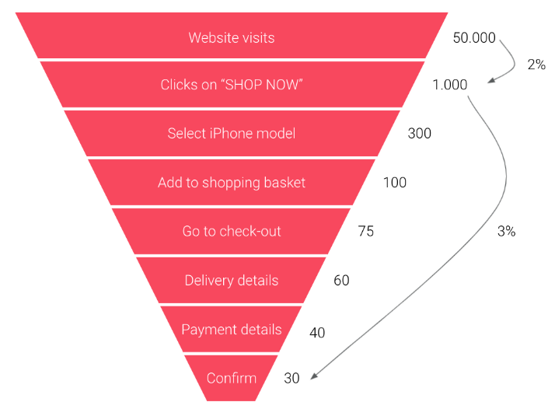
Project analysis slide 2
Conversion Rate Metrics

Slide 4
Project analysis slide 2
Experiment with other elements
Big “Search bar”
Login button
Menu on top
Shopping cart with catchy colour
Live chat box
Recommendation products
Map button on dashboard

Slide 5
Project analysis slide 2
Analytic Tools
Optimizely
VWO
Convert Experiences
Site Spect
AB Tasty
Evolv
Google Optimize
Qubit
Adobe Target
Marketing Tools With Built-In Testing
Clicks by Chance?
Identifying the visitor by the cookie
source: https://conversionsciences.com/ab-testing-tools/

Slide 6
Project analysis slide 2
Experiment duration
Start
2 Weeks
Analyse
Test Low and High traffic
Statistical reliability – 95%-99%
Minimum 5000 visitors

